Slide 1
CSS342 Data Structures, Algorithms, and Discrete Mathematics (I)

Slide 2
A TALE OF TWO SINGLE LINKED LIST REVERSALS
CSS143

Slide 3
Special Topic
Reverse A Single Linked List
head
Next
Next
Next
Next
end
h→1→2→3→4→n
Input:
h→4→3→2→1→n
output:
Reversing node, not values in the nodes

Slide 4
Possible Solution
How did we do this for Array?
12
12
1
7
18
10
3
What’s the complexity?

Slide 5
Possible Solution
Can we apply this to Single Linked List
head
12
12
12
1
7
18
10
3
null
What’s the complexity?

Slide 6
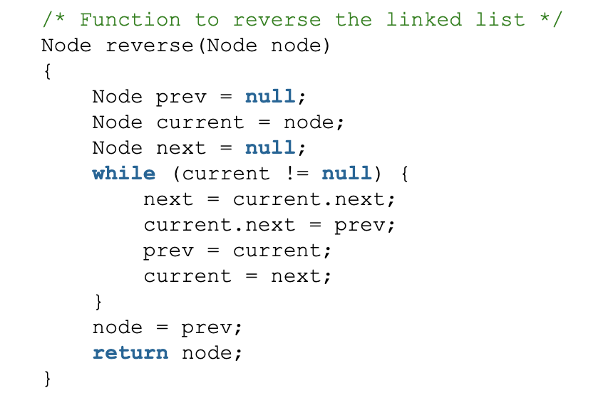
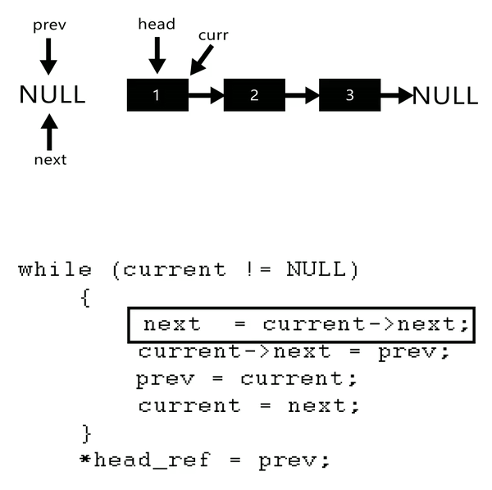
Reverse A Linked List
Two ways to do it:
Iterative
Recursive
https://www.geeksforgeeks.org/reverse-a-linked-list/

Slide 7
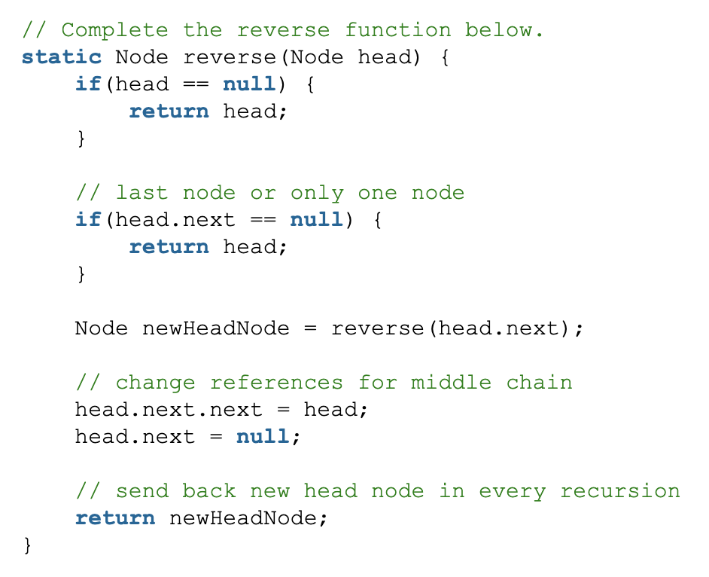
Reverse A Linked List
Two ways to do it:
Iterative
Recursive

Slide 8
Goals
Answer the following question?
Why are there two ways to reverse a linked list?
Are the two ways really that different?

Slide 9
Reverse A Linked List
Describe how to reverse a single linked list
h→1→2→3→4→n
Start: ???
Loop {
Step 1: ???
Step 2: ???
}

Slide 10
An Idea
1-> 2
2-> 1
1-> 2-> 3
2->1->3
3->2->1
Starting from the head node
Iteratively swap each node to the front
3-> 4-> 1->9

Slide 11
Demo 1:
Volunteers please!

Slide 12

Demo 3
h
1
2
3
4
n
2

Slide 13
Demo 3
h
2
1
3
4
n
3

Slide 14
Demo 3
h
3
2
1
4
n
4

Slide 15
Reverse A Linked List
Describe how to reverse a single linked list
h→1→2→3→4→n
Start: front
Loop {
Step 1: Find the next node
Step 2: move it next to head
}
Start: ???
Loop {
Step 1: ???
Step 2: ???
}
Hint: this is the iterative method

Slide 16
Reverse A Linked List
In the last method, We started from the left
h→1→2→3→4→n
But what if we start from right?

Slide 17
Demo 4
h
1
2
3
4
n
3

Slide 18
Demo 4
h
1
2
4
3
n
2

Slide 19
Demo 4
h
1
4
3
2
n
1

Slide 20
Reverse A Linked List
Describe how to reverse a single linked list
h→1→2→3→4→n
Start: from tail
Loop {
Step 1: Find the next node
Step 2: move it next to end
}
Start: ???
Loop {
Step 1: ???
Step 2: ???
}
Hint: this is the recursive method

Slide 21
Reverse A Linked List
h
1
2
3
4
n
going from front to end: next node = thisNode.next
going from end to front: next node = ?
How to access a linked list nodes from end to front?
recursion

Slide 22
Demo 4
h
1
2
3
4
n
Reverse(head) {
3
Reverse(1) {
Reverse(2) {
Reverse(3) {

Slide 23
Demo 4
h
1
2
4
3
n
2
Reverse(head) {
Reverse(1) {
Reverse(2) {

Slide 24
Demo 4
h
1
4
3
2
n
1
Reverse(head) {
Reverse(1) {

Slide 25
Demo 4
h
4
3
2
1
n
Reverse(head) {

Slide 26
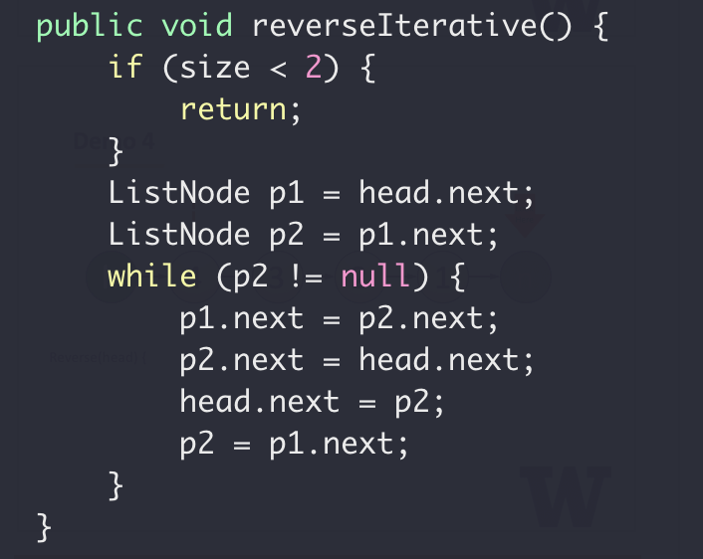
Reverse Linked List
Iterative
Front front
Find the next element
Move next to head
p1
p2
h
1
2
3
4
n

Slide 27
Reverse Linked List
Iterative
Front front
Find the next element
Move next to head
p1
p2
h
2
1
3
4
n

Slide 28
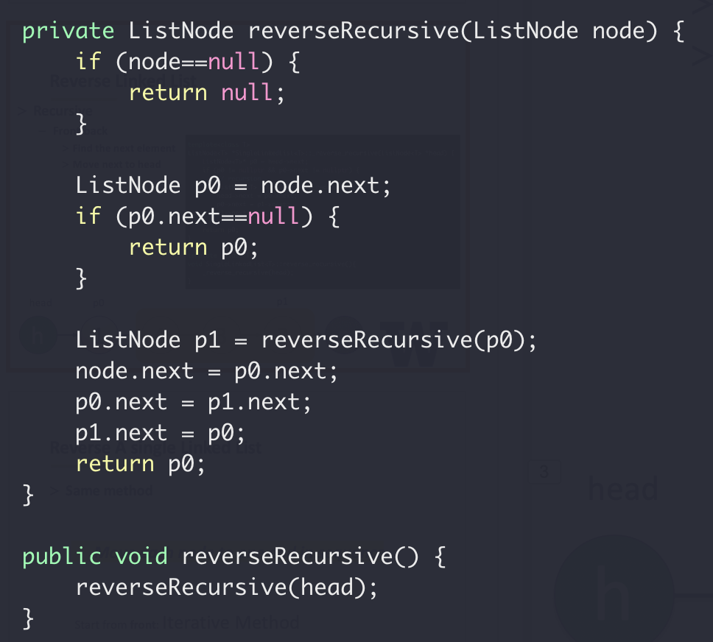
Reverse Linked List
Recursive
Front back
Find the next element
Move next to head
head
p0
p1
h
1
4
3
2
n

Slide 29
Reverse A single Linked List
Same method
Move each node to one end in sequence
Start from front: Iterative Method
Start from end: Recursive Method

Slide 30
Reverse A single Linked List
Recursive method:
Walk to the far end and work backward from there
Sounds familiar?

Slide 31
Recursive Linked List Print
Print linked list values backward
inplace
head
8
3
2
9
5
6
null
6→5 → 9 → 2 → 3 → 8

Slide 32
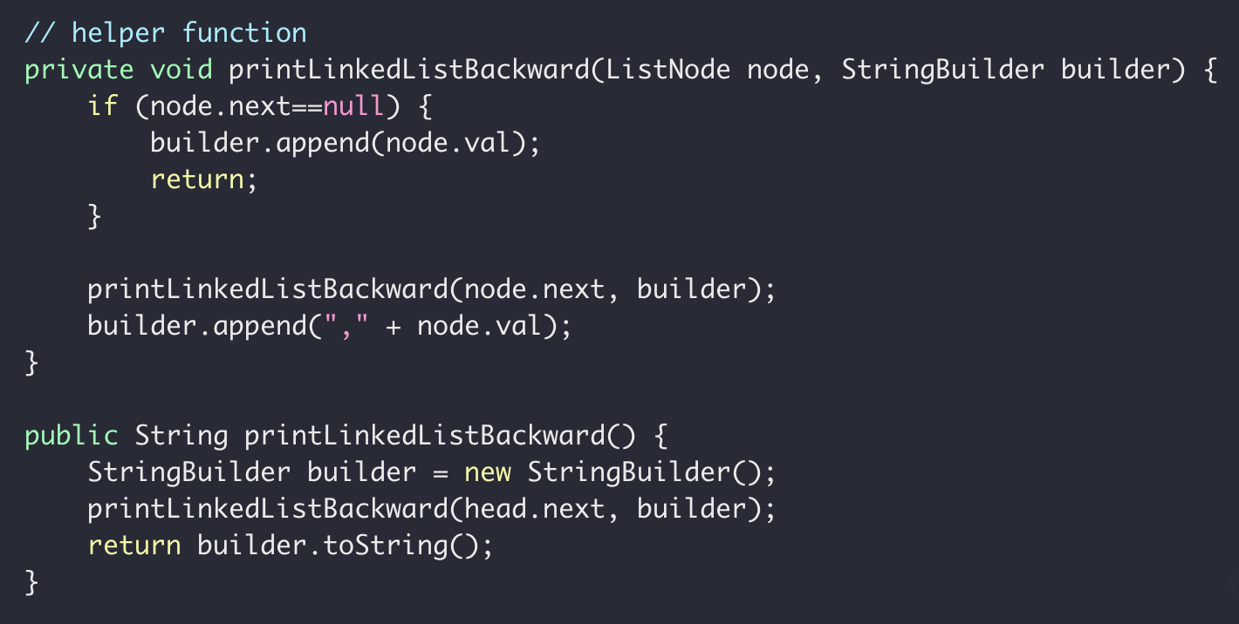
Recursive Linked List Print

Slide 33
Reverse A single Linked List
Recursive method:
Walk to the far end and work backward from there
Binary Tree Traversal (post-order)
Depth-First Search (DFS)

Slide 34
Goals
Answer the following question?
Why are there two ways to reverse a linked list?
Are these two ways really that different?

Slide 35
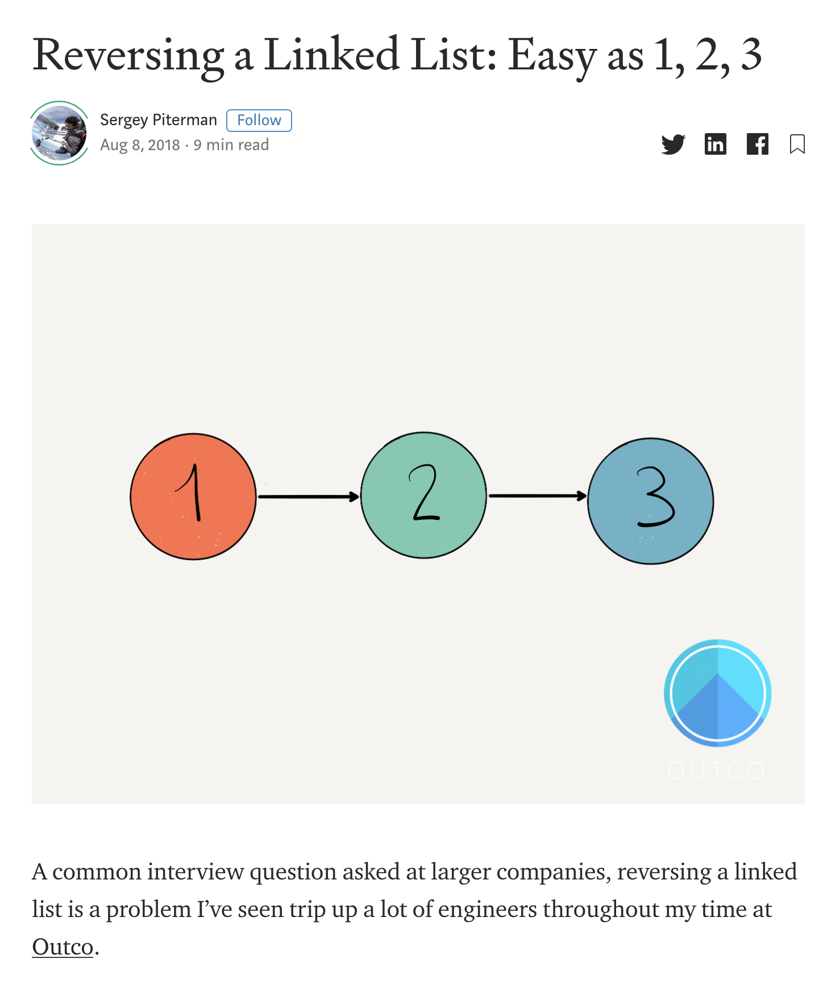
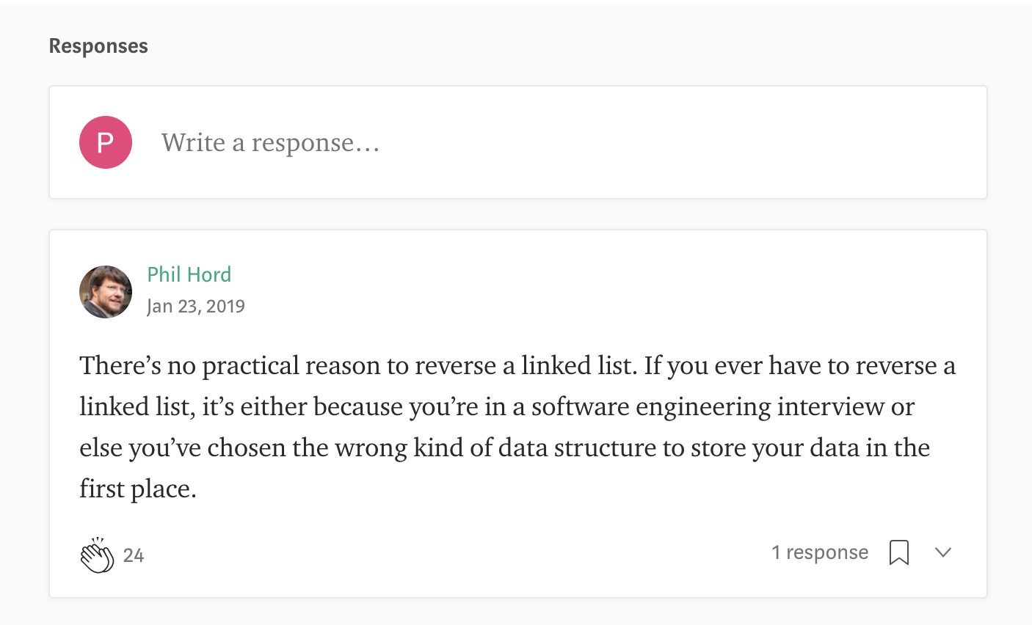
Why on earth…
What’s the use of reversing a linked list?
https://medium.com/outco/reversing-a-linked-list-easy-as-1-2-3-560fbffe2088

Slide 36
Single Linked List Reversal
Two Implementations
forward / backward
iterative / recursive
One Algorithm
Swap every node to (either) end

